Slide 1

Momentum
      how much stuff is moving (mass)
      how fast the stuff is moving(velocity)
      Momentum = mass (kg) × velocity (ms⁻¹)
p = m × v

Slide 2

Conservation of momentum
Conservation of Momentum
Conservation of momentum

Slide 3
What is conservation of momentum?
In any collision, the total momentum before collision is equal to the total momentum after collision, provided that there is no external force acting.
If F_{ext} = 0
P _{before} = P _{after}

Slide 4
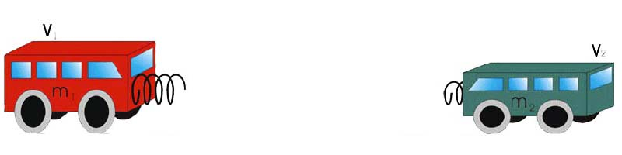
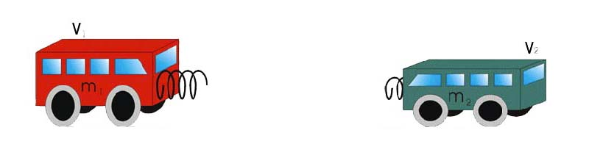
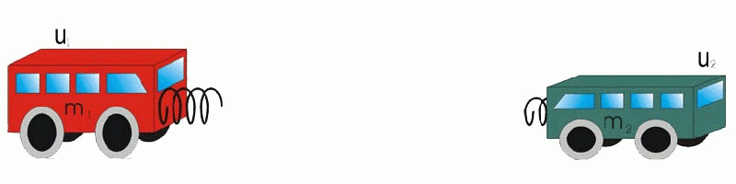
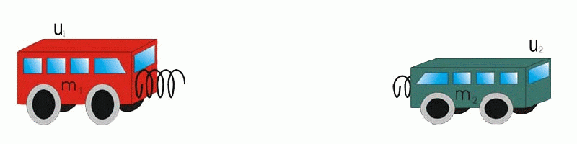
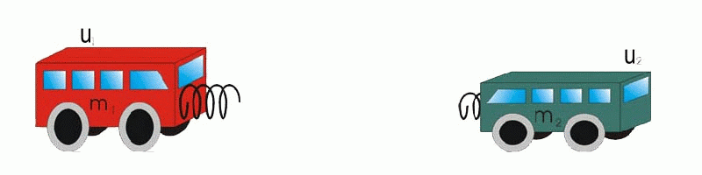
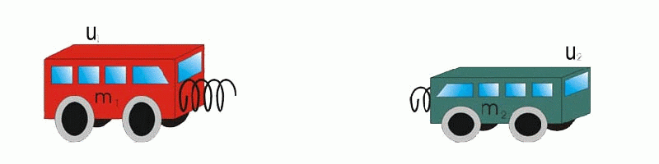
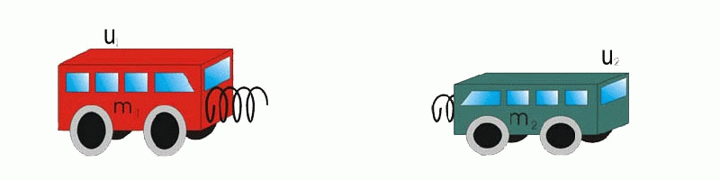
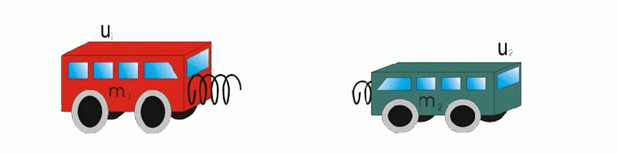
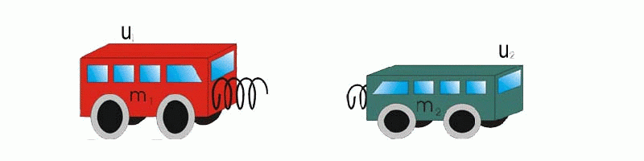






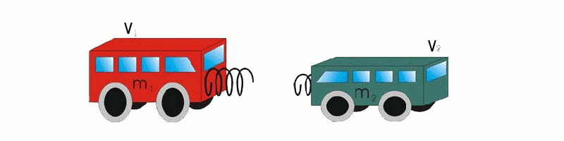
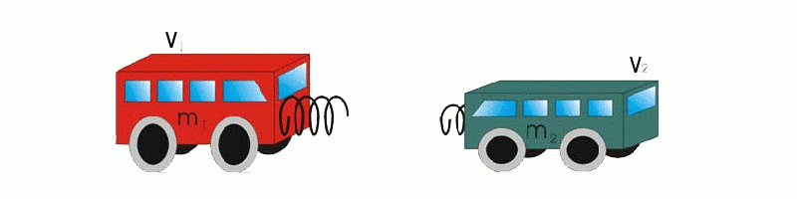
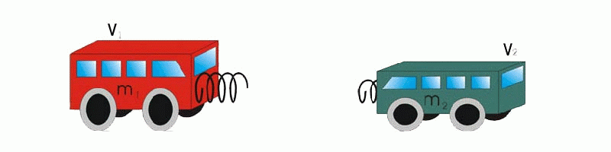
When F_{ext} = 0,
Before collision
m₁u₁ + m₂u₂
m₁v₁ + m₂v₂
=
After collision

Slide 5

PROBLEM
A 20 g marble travels to the right at 0.4 ms⁻¹ on a smooth, level surface. It collides head-on with a 60 g marble moving to the left at 0.2 ms⁻¹. After collision, the 20 g marble rebounds at 0.1 ms⁻¹. Find the velocity of the 60 g marble.

Slide 6

Solution
Step 1
Make a sketch showing the direction, masses and velocities of each object before collision.
Before collision:
0.2ms⁻¹
0.4ms⁻¹
+ ve
0.06kg
0.02kg
Step 2
Assign one direction as the positive direction.
Assume that the 0.06 kg marble continues to move to the left after the collision at a velocity v. Take the direction to the left as positive.

Slide 7
After collision
Before collision:
Step 3
Make a sketch showing the direction, masses and velocities of each object after collision.
0.2ms⁻¹
0.4ms⁻¹
0.1ms⁻¹
+ ve
+ ve
v
0.06kg
0.02kg
0.06kg
0.02kg

Slide 8
Step 4
Write down the equation for conservation of momentum and substitute the known values of each object after collision.
As no external force exists during the collision,
by the law of conservation of momentum
m₁u₁ + m₂u₂ = m₁v₁ + m₂v₂
(0.06 kg * 0.2 ms⁻¹) + (0.02 kg*-0.4ms⁻¹)
= (0.06 kg * v) + (0.02 kg*0.1ms⁻¹)
m₁u₁
+
m₂u₂
=
m₁v₁
+
m₂v₂
Step 5
Solve the equation to find out the unknown value.
The velocity of the 60 g marble is 0.033 ms⁻¹ to the left.
v = 0.033 ms⁻¹

Slide 9





QUESTION 1
In the following figure, two particles of masses 1kg and 2kg are moving in the same direction at speed of 30 cms⁻¹ and 15 cms⁻¹ respectively, If they stick together after collision, the final speed of the particles is
30 cms⁻¹
15 cms⁻¹
1 kg
2 kg
10 cm s⁻¹
15 cm s⁻¹
20 cm s⁻¹
25 cm s⁻¹
30 cm s⁻¹

Slide 10
QUESTION 2
Two objects A and B of masses 2 kg and 1 kg respectively move in opposite directions. They collide head on. After the collision, the velocity of A becomes 1 m s⁻¹ towards the left. What would be the velocity of B ?
2 ms⁻¹
4 ms⁻¹
A
B
2 m s⁻¹ towards the right
3 m s⁻¹ towards the left
4 m s⁻¹ towards the left
3 m s⁻¹ towards the right
4 m s⁻¹ towards the right

Slide 11
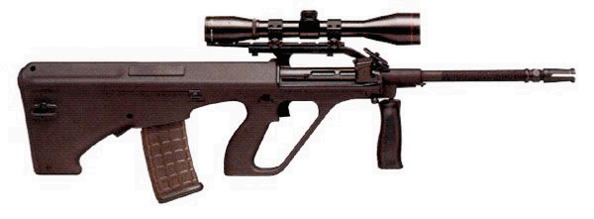

Shooting gun
Why does the gun recoil(move backwards) after firing?

Slide 12
By the law of conservation of momentum,
m₁u₁ + m₂u₂ = m₁v₁ + m₂v₂
Before firing, both the gun and the bullet have zero momentum
i.e. m₁u₁ + m₂u₂ = 0
The Gun Recoil
After firing, the bullet moves forward, and have a forward momentum
So, the gun must have a backward momentum

Slide 13
Collision
There are three kinds of collision
  Elastic collision
  Inelastic collision
  Partially elastic collision

Slide 14
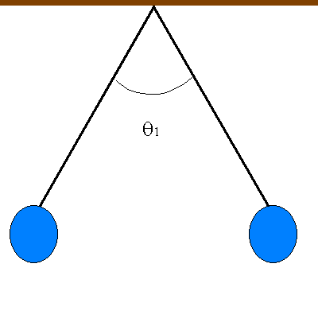
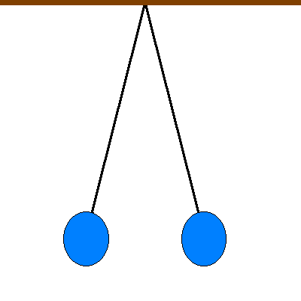
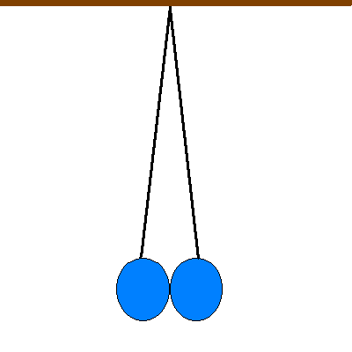
Elastic Collision
The two identical balls hit each other and bounce back to the same level
Animation of
two balls

Slide 15
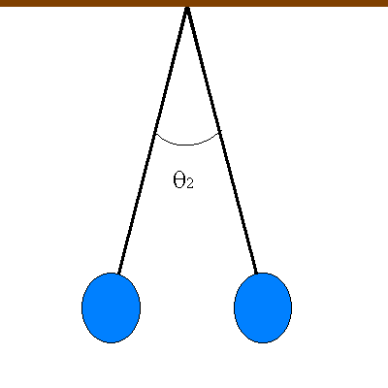
Partially Elastic Collision
The balls bounce back to a lower level

Slide 16
Inelastic Collision
  The balls do not bounce
  i.e. they stick
  together

